Slide 1


Hands-On Reinforcement Learning For Stock Trading Using FinRL
TAIS NextGen-Tunisian AI Society
SympactAI
Presented by
Moez KESSEMTINI
Mazen TMANI
Supervised by
Mr.Mahdi Kallel
Mrs.Imen Ghazouani
Saturday, August 16, 2025

Slide 2
Outline
01
02
03
Opening Hook
RL &
Stock Trading
FinRL & Trading Environment
04
05
06
RL Workflow in FinRL
Results &
Evaluation
Future Directions

Slide 3

01
Opening Hook

Slide 4

Problematic
About 95% of retail traders lose money due to behavioral biases like overconfidence and poor risk management (Medium 2022)
Jane Street (India, 2023–2025): Retail investors lost $21.7B in derivatives trading (Reuters, 2025)
Notes:
In 2023, Kaspersky reported a significant increase in mobile device attacks, reaching nearly 33.8 million, which marks a 52% rise compared to 2022.
90% of mobile malware now uses stealth techniques such as permission abuse, background execution, and hidden payloads.(Source: AV-Test Institute)

Slide 5
Can algorithms and AI solve those
Problems ?

Slide 6
Motivation
In 2023, 37% of overall U.S. equity trading volume was executed through algorithms
The global reinforcement learning market is expected to grow from $2.8B in 2022 to $88.7B by 2032
Real-World
Statistics
What about implementing RL algorithms in trading ?

Slide 7

02
RL
&
Stock Trading

Slide 8
Core Concepts of Reinforcement Learning
Agent: the learner or decision-maker
Environment: the system or market the agent interacts with
State: current situation or information available to the agent
Action: decisions or moves taken by the agent
Notes:
To begin with, malware detection approaches are mainly categorized into two types: static and dynamic analysis.
In static analysis, the APK is inspected without being executed. It involves examining permissions, API calls, and code structure—this makes it fast and suitable for large-scale analysis. However, it can be tricked by obfuscation techniques.
On the other hand, dynamic analysis runs the app in a sandboxed environment to monitor real-time behavior like system calls or network traffic. It’s harder to evade, but slower and more resource-intensive.
Our project focuses on static analysis, which is used most stable detectors like MamaDroid and Malscan due to its efficiency.

Slide 9
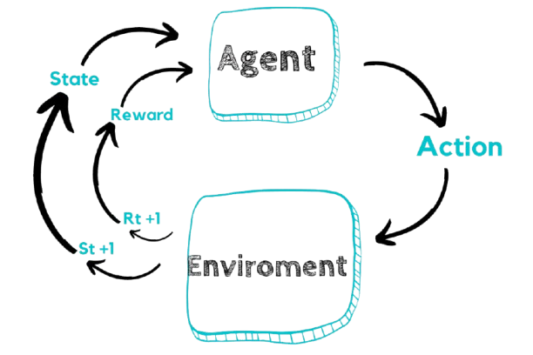
Reward: feedback received based on the action’s outcome
Policy: strategy that maps states to actions
Value Function: estimates expected future rewards
Notes:
To begin with, malware detection approaches are mainly categorized into two types: static and dynamic analysis.
In static analysis, the APK is inspected without being executed. It involves examining permissions, API calls, and code structure—this makes it fast and suitable for large-scale analysis. However, it can be tricked by obfuscation techniques.
On the other hand, dynamic analysis runs the app in a sandboxed environment to monitor real-time behavior like system calls or network traffic. It’s harder to evade, but slower and more resource-intensive.
Our project focuses on static analysis, which is used most stable detectors like MamaDroid and Malscan due to its efficiency.

Slide 10

Why RL is Ideal for Stock Trading
Dynamic & Uncertain Markets
Advantages over Traditional Methods:
Adapts in real-time
Handles complex, nonlinear relationships
Incorporates risk management constraints (drawdown limits, portfolio volatility)
RL agents learn by trial and error, adapting to changing market conditions
Strategies continuously evolve by learning from new market data and adapting to emerging trends
Notes:
To begin with, malware detection approaches are mainly categorized into two types: static and dynamic analysis.
In static analysis, the APK is inspected without being executed. It involves examining permissions, API calls, and code structure—this makes it fast and suitable for large-scale analysis. However, it can be tricked by obfuscation techniques.
On the other hand, dynamic analysis runs the app in a sandboxed environment to monitor real-time behavior like system calls or network traffic. It’s harder to evade, but slower and more resource-intensive.
Our project focuses on static analysis, which is used most stable detectors like MamaDroid and Malscan due to its efficiency.

Slide 11

03
FinRL & Trading Environment

Slide 12

What is FinRL?
Open-source RL framework developed by AI4Finance
Built on: PyTorch, Stable Baselines3, Gym interface
Pre-built trading environments
Integration with financial data sources (Yahoo Finance, Quandl…)
ideal for experimentation, research, and practical RL trading projects

Slide 13
FinRL Trading Environment
Realistic constraints
Components
State space: prices, technical indicators, portfolio info
Action space: buy, sell, hold (and position sizing)
Reward function: portfolio value, Sharpe ratio
Transaction costs
Risk management parameters

Slide 14
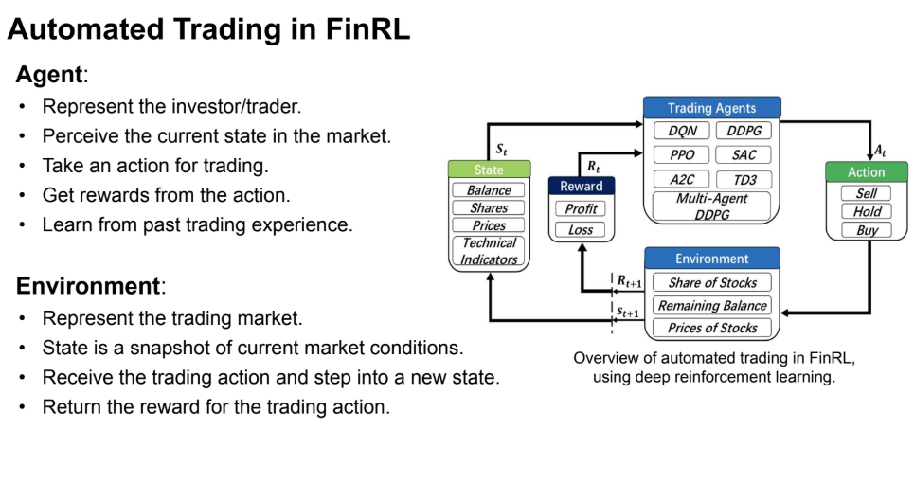

Slide 15
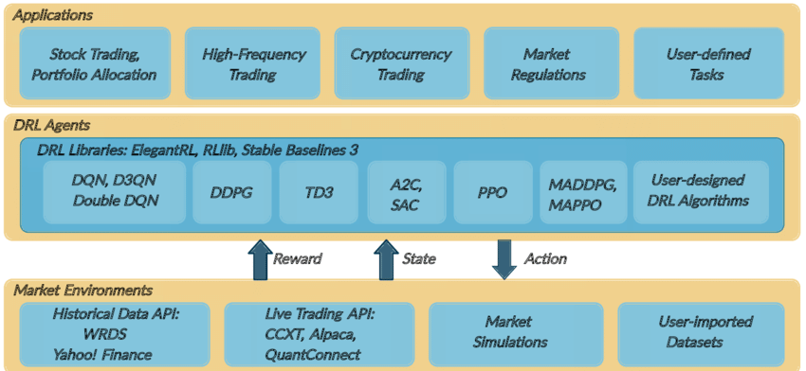
FinRL Layers :

Slide 16
04
RL Workflow in FinRL

Slide 17
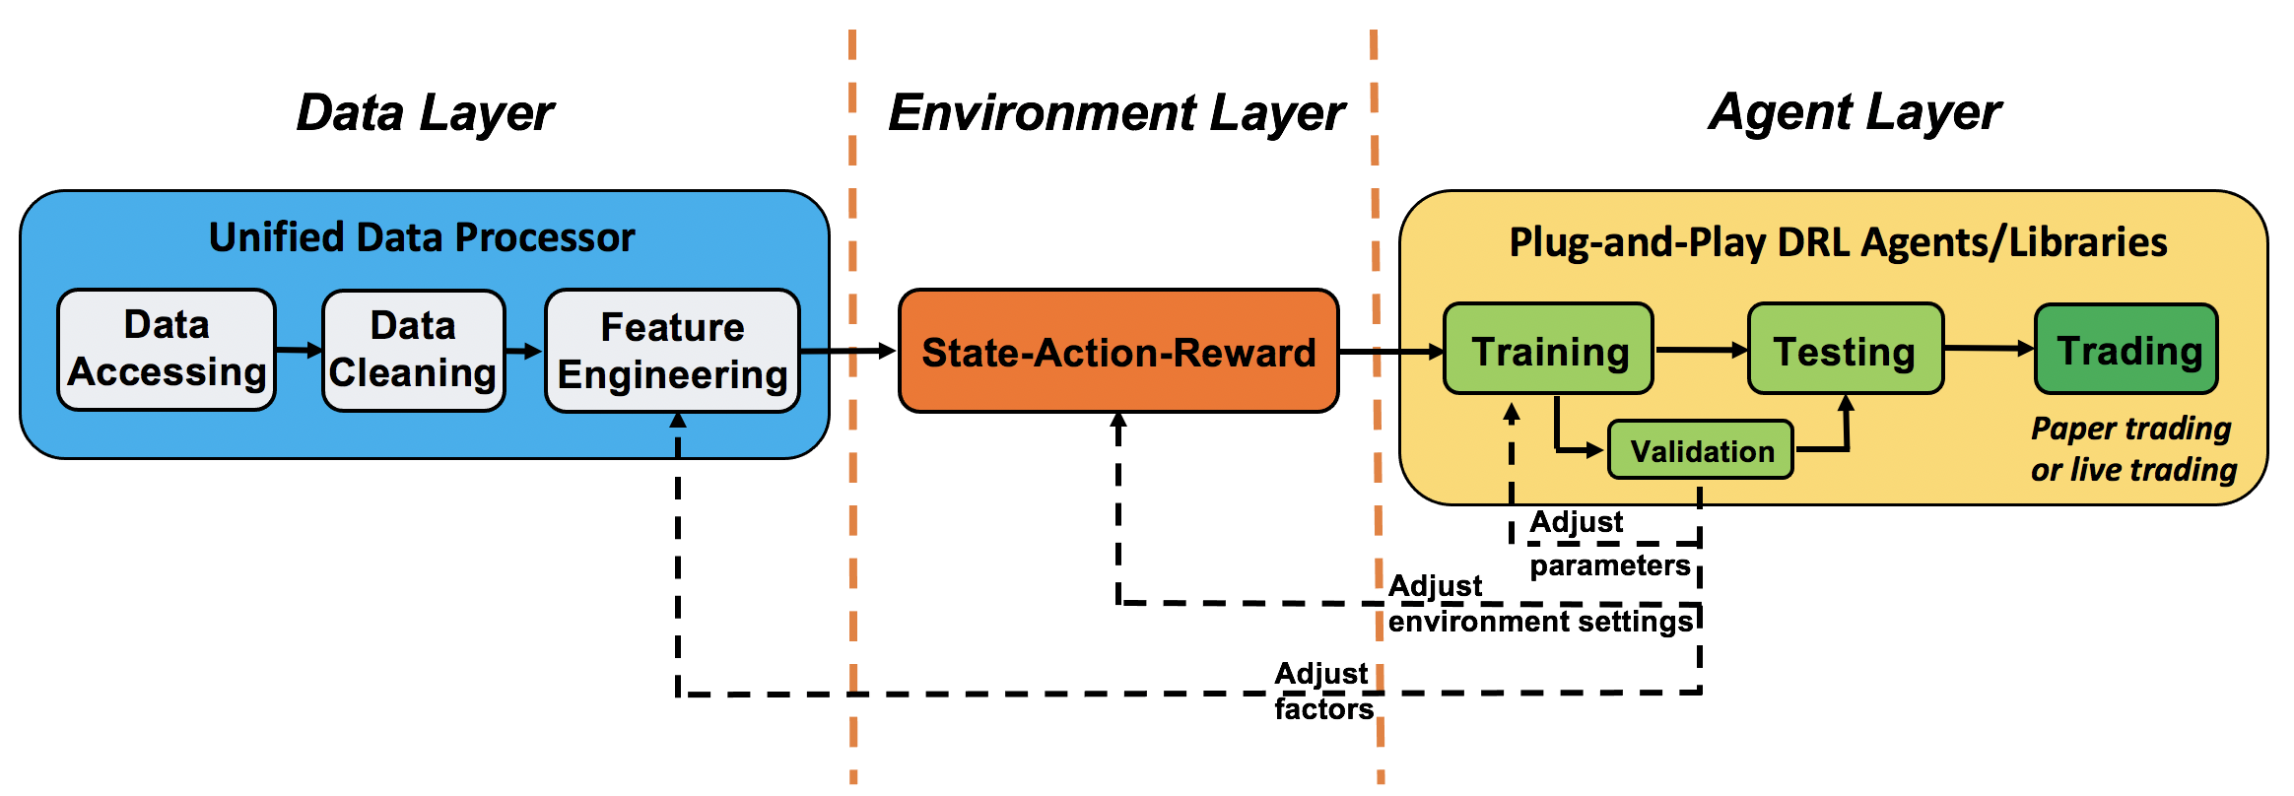

Slide 18
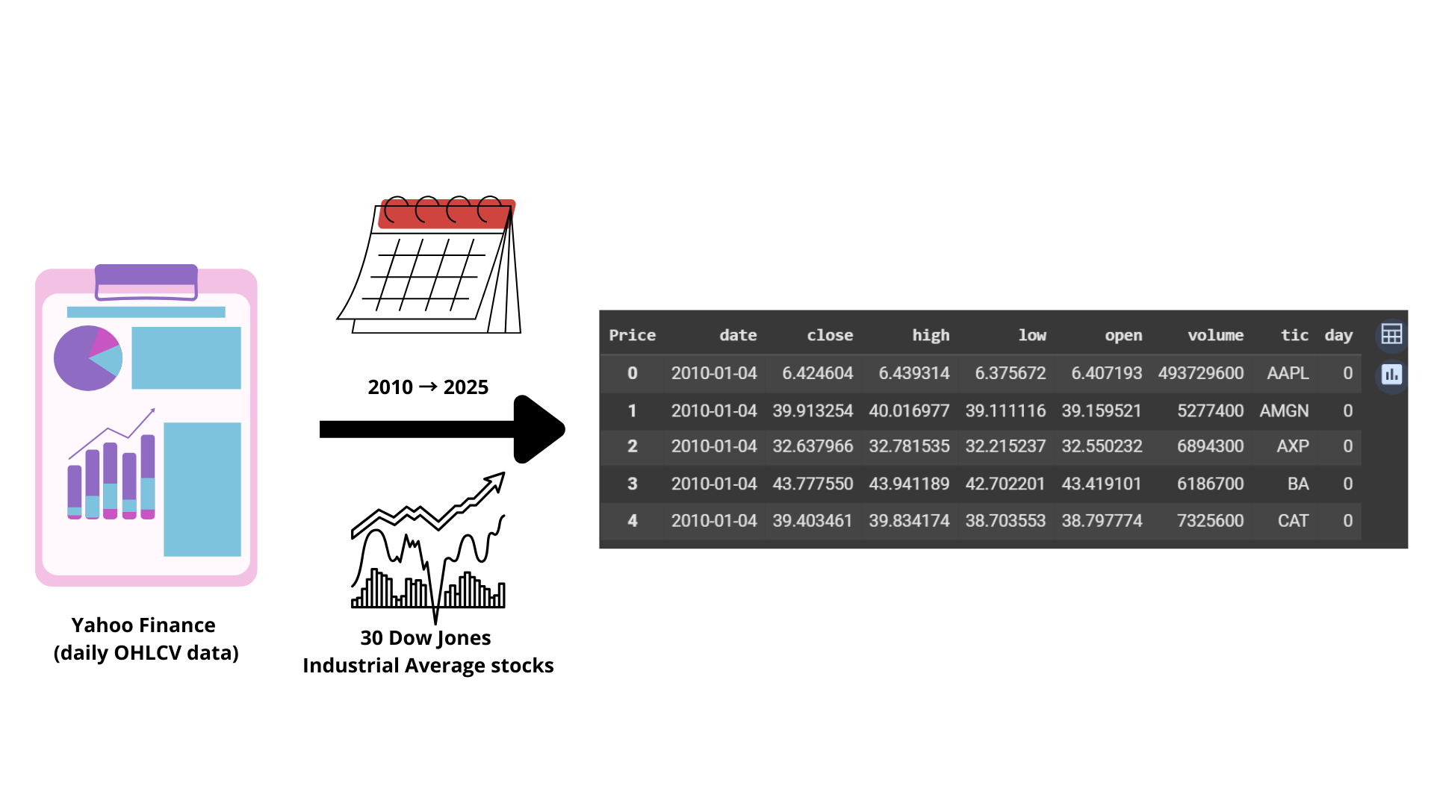
Data Collection

Slide 19
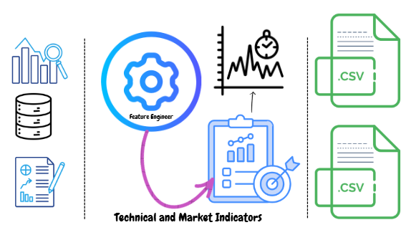
Data Preprocessing

Slide 20
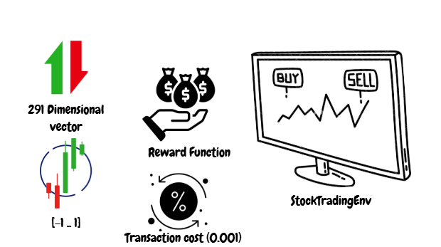
Stock Trading Environment

Slide 21
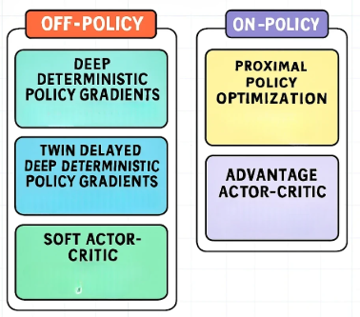
RL Algorithms and Libraries
Notes:
To begin with, malware detection approaches are mainly categorized into two types: static and dynamic analysis.
In static analysis, the APK is inspected without being executed. It involves examining permissions, API calls, and code structure—this makes it fast and suitable for large-scale analysis. However, it can be tricked by obfuscation techniques.
On the other hand, dynamic analysis runs the app in a sandboxed environment to monitor real-time behavior like system calls or network traffic. It’s harder to evade, but slower and more resource-intensive.
Our project focuses on static analysis, which is used most stable detectors like MamaDroid and Malscan due to its efficiency.

Slide 22
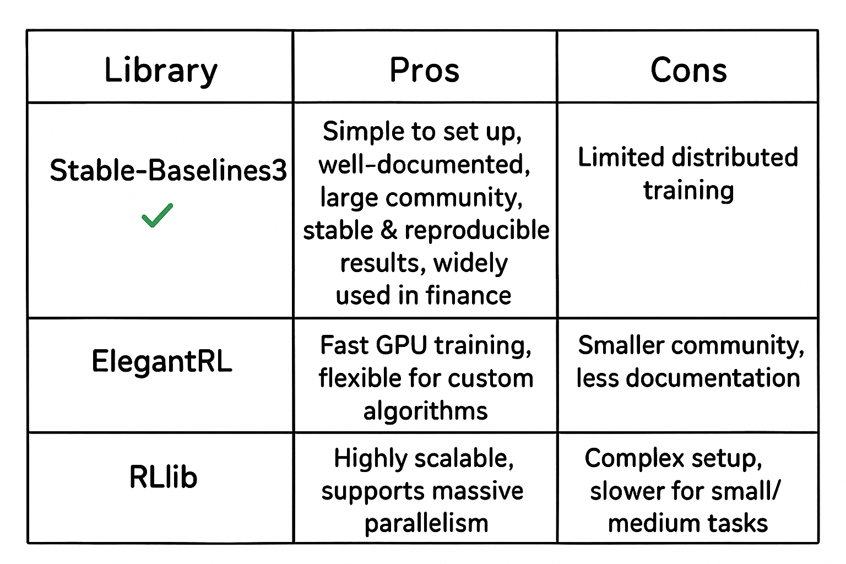
Notes:
To begin with, malware detection approaches are mainly categorized into two types: static and dynamic analysis.
In static analysis, the APK is inspected without being executed. It involves examining permissions, API calls, and code structure—this makes it fast and suitable for large-scale analysis. However, it can be tricked by obfuscation techniques.
On the other hand, dynamic analysis runs the app in a sandboxed environment to monitor real-time behavior like system calls or network traffic. It’s harder to evade, but slower and more resource-intensive.
Our project focuses on static analysis, which is used most stable detectors like MamaDroid and Malscan due to its efficiency.

Slide 23
Agents Training
Training Paradigms
Rolling Training: Periodically retrain with new data to adapt to evolving market conditions.
Static Training: Train once on historical data, then test on future unseen data.
Notes:
To begin with, malware detection approaches are mainly categorized into two types: static and dynamic analysis.
In static analysis, the APK is inspected without being executed. It involves examining permissions, API calls, and code structure—this makes it fast and suitable for large-scale analysis. However, it can be tricked by obfuscation techniques.
On the other hand, dynamic analysis runs the app in a sandboxed environment to monitor real-time behavior like system calls or network traffic. It’s harder to evade, but slower and more resource-intensive.
Our project focuses on static analysis, which is used most stable detectors like MamaDroid and Malscan due to its efficiency.

Slide 24
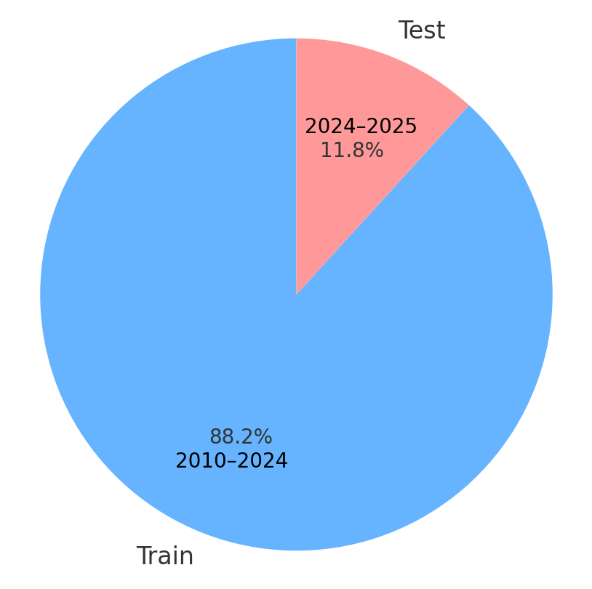
Data Distribution :
Static Training
Rolling Training
Retrain periodically during 2024–2025 to capture market regime shifts
Notes:
Now let’s look at two machine learning-based malware detectors we target: MamaDroid and Malscan.
MamaDroid builds Markov chains based on sequences of API calls. It captures behavioral patterns of applications and feeds them into classifiers like Random Forest or KNN.
In contrast, Malscan extracts multiple static features—such as permissions, opcodes, and activities—and uses them with classifiers like SVM or Gradient Boosting.

Slide 25
Trade-offs
Static: Simple, low computational cost, but not adaptive to market changes
Rolling: Adapts to new data and market shifts, but higher computational cost.

Slide 26
05
Results &
Evaluation

Slide 27
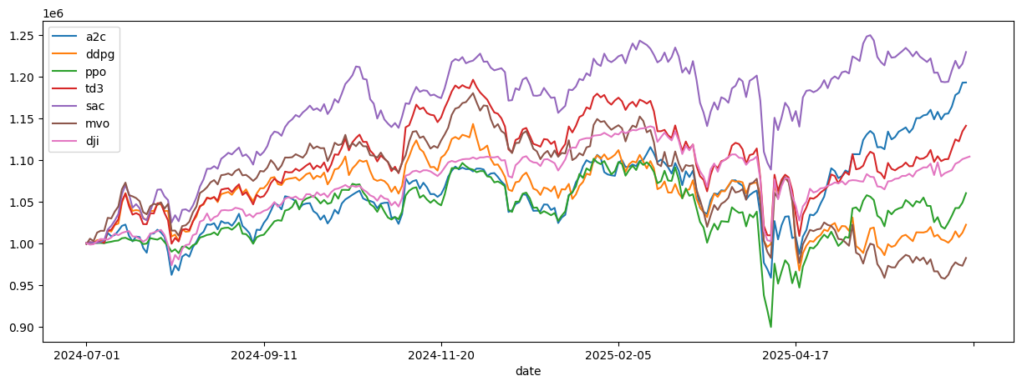
Cumulative returns for DRL agents and benchmarks

Slide 28
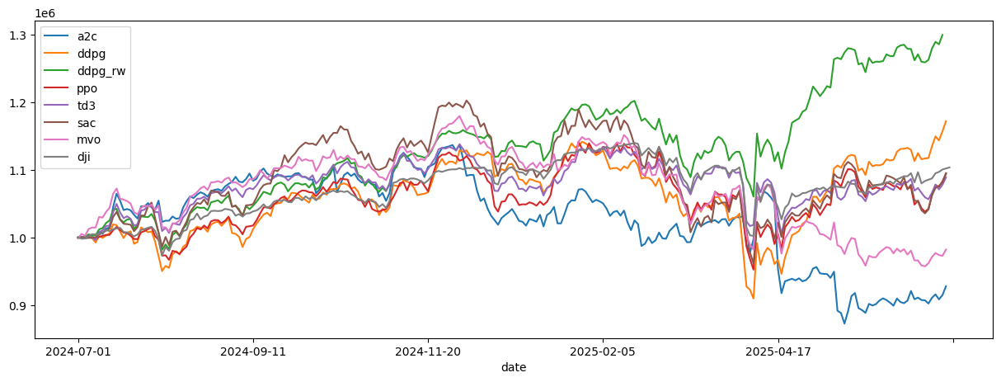
Performance with DDPG retrained via expanding rolling window

Slide 29
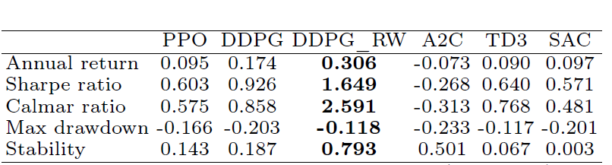
Selected performance metrics for all Agents

Slide 30
Agent performance varies by algorithm and settings
Using rolling window training, DDPG outperforms all other
RL algorithms
The rolling window strategy proved effective in boosting returns and reducing risk

Slide 31
06
Future Directions

Slide 32

Integration with News & Sentiment Analysis: leverage financial news and social media for improved decision-making
Real-Time Trading Deployment: deploy RL agents in live or paper trading environments
Ensemble of RL Agents: combine multiple RL strategies for more robust performance
Notes:
Our custom-trained MLP model shows stronger resilience to JSMA attacks compared to existing approaches
It is less vulnerable and maintains higher performance under adversarial conditions
The diverse mix of APKs in our dataset significantly strengthened model robustness and generalization

Slide 33
Thank you for your attention

